Slide 1

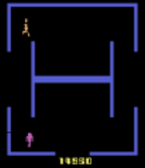
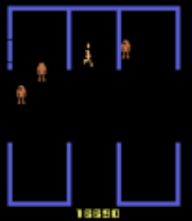




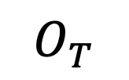
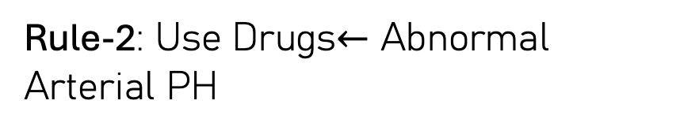
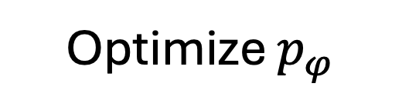
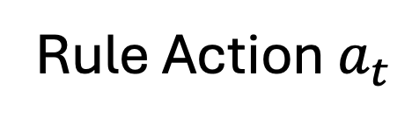
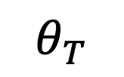
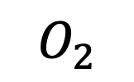



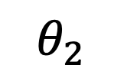
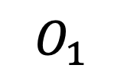
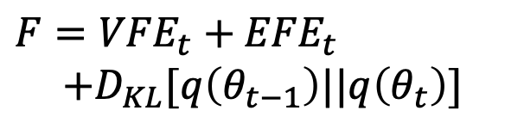
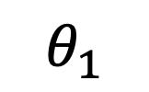




Biologically
Human Behavior
World Model
Query LLM for Intention States: Decide how many latent z states should be used. Provide interpretation
……
Values
Output
Values
Output
Environment
Attention $p_{φ}$
Attention $q_{θ}$
$$O_{1}$$
$$O_{2}$$
…
$$O_{T}$$
Keys
Query
Keys
Query
Wake
Sleep
Update $q_{θ}$
Goal: Minimize Free Energy
Optimize $p_{φ}$
$$θ_{T}$$
Harvest Rules
$F={VFE}_{t}+$ ${EFE}_{t}$
$$+D_{KL}[q\left(θ_{t−1}\right)||q\left(θ_{t}\right)]$$
Refine Rules
$$θ_{2}$$
Min. Total $F$
$$θ_{1}$$
Min. VFE
Prune Low-Conf
Brain
Habitual Policy and Action Selection
Habitual Rule Construction
Rule Matching Engine
Rule Action $a_{t}$
Rule-1: Intravenous Fluids $←$ Abnormal SysBP
Rule-r is active at time t iff
$$z_{t}^{MAP}=z_{r}$$
Rule
Hit?
EFE Planning
(Beam Search)
Human Action
Rule-2: Use Drugs$←$ Abnormal Arterial PH
$κ_{r}(S_{t}^{MAP},S_{r})≥$ $τ_{r}$

